Slide 1

NU - 302: Image Classification
Prepared by: Mentored by:
Anirudh Sharma Dr. Prashant Srivastava
Bollam Sreekar Reddy
Potlacheruvu Sai Krishna Vamsi
Shravan Sridhar
Tavva G. N. R. S. N Prudhvith 07.02.2019

Slide 2
Overview
Rationale of the Project
Objective
Review of Literature
Methodology
Expected Deliverables

Slide 3
Rationale of the Project
On the surface, teaching a computer to do something like image classification seemed very intriguing to us.
Moreover, there are countless real-world applications of this topic, for instance: filtering in stock photography websites, etc.
Since a lot of research on this topic has already been done, there are already quite a few solutions that we can learn from.

Slide 4
Objectives
To develop our concept of image classification from the ground-up, i.e, explore machine learning techniques first and then move onto deep learning techniques.
To research the underlying principles and techniques of image classification.
We also aim to by the end, deliver a novel technique based on already existing concepts such as traditional machine learning and deep learning techniques.

Slide 5
Review of Literature

Slide 6
Paper 1
The aim is to provide a brief overview of some of the most common image classification methods and compare them.
A Survey on Image Classification Methods
Jipsa Kurian
V. Karunakaran
(IJARECE 2012)
Volume 1, Issue 4, October 2012
ISSN: 2278-909X

Slide 7
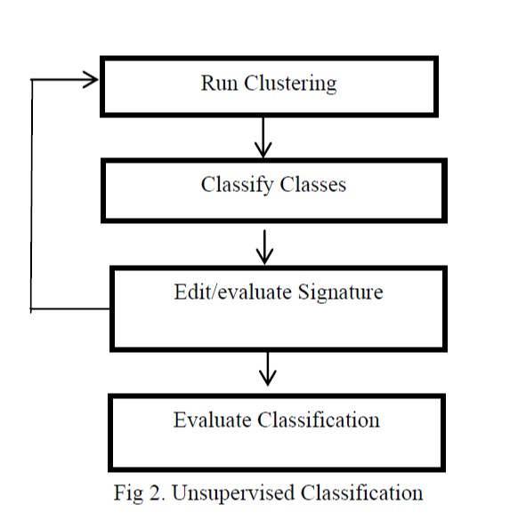
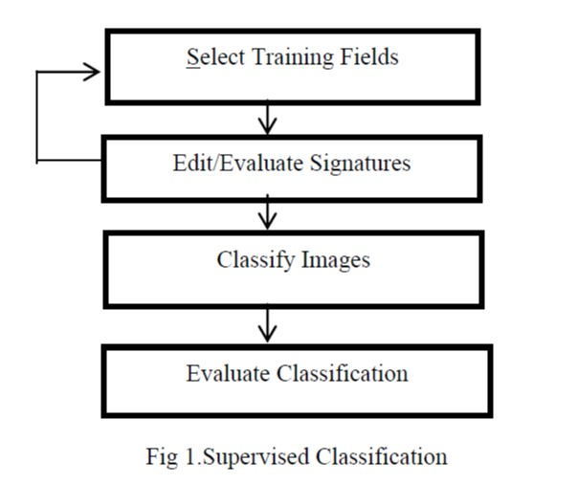
Abstract
The two main image classification methods: Supervised and Unsupervised Classification
https://pdfs.semanticscholar.org/8fcc/28ca0cd491c62868ee8866784ee6cf40f374.pdf

Slide 8
Accuracy
Supervised Classification
Linear Discriminant Analysis (LDA) 70%
Support Vector Machine (SVM) 71.10%
Artificial Neural Network (ANN) 72.50%
Unsupervised Classification
Self Organizing Tree Algorithm (SOTA) 81.95%
https://pdfs.semanticscholar.org/8fcc/28ca0cd491c62868ee8866784ee6cf40f374.pdf
Notes:
LDA is equivalent to logistic regression SOTA -

Slide 9
Paper 2
This paper attempts to study and provide a brief knowledge of the different image classification approaches and different classification methods.
A Survey on Image Classification approaches and techniques
Pooja Kamavisdar,
Sonam Saluja
Sonu Agrawal
(IJARECE 2013)
Volume 2, Issue 1, January 2013
ISSN: 2319-5940

Slide 10
Abstract
This survey gives theoretical knowledge about different classification methods and provides the advantages and disadvantages of various classification methods.
Some of the different classifiers are supervised and unsupervised; parametric and nonparametric; spectral, contextual and spectral-contextual; hard and soft classification.
https://pdfs.semanticscholar.org/9509/c435260fce9dbceaf44b52791ac8fc5343bf.pdf

Slide 11
Paper 3
The main motive of this literature survey was to compare different data sampling techniques.
Review of Image Classification methods and techniques
Maneela Jain
Pushpendra Singh Tomar
(IJERT 2013)
Volume 2, Issue 8, August 2013
ISSN: 2278-0181

Slide 12
Abstract
The image classification techniques explored in this survey paper were
Artificial Neural Network - Supervised Learning
SVM - Supervised Learning
DAG-SVM - Supervised Learning
Fuzzy Decision Trees - Unsupervised Learning
Supervised learning: When dealing with labelled data.
Unsupervised Learning: When dealing with unlabeled data.
Semi-supervised Learning: When the training data contains combination of labelled and unlabelled data.
https://www.ijert.org/research/review-of-image-classification-methods-and-techniques-IJERTV2IS80157.pdf

Slide 13
Abstract
Semi-Supervised learning algorithms are more advantageous compared to both supervised and unsupervised.
Initially a model is prepared with the existing labelled data and then this model is used to assign pseudo-label to the remaining unlabelled data which has high probability of being a particular class.
This process is repeated till the training data is exhausted.
As in supervised learning, there is no need to label the entire training set which is a time consuming process.
https://www.ijert.org/research/review-of-image-classification-methods-and-techniques-IJERTV2IS80157.pdf

Slide 14
Model | Description | Disadvantages
Artificial neural Network | ANN is a collection of layers it generally contains input, hidden and output layers. These layers are joined by weighted links. | Choosing the right network architecture is often difficult.
DAG-SVM | An extension of SVM technique for multiclass classification. | Performance of result evaluation shows that DAG-SVM is not a better classifier.
FDT | FDT uses the advantages of both the methods i.e. Fuzzy and decision tree. | No training so prior knowledge about the desired area is required.
https://www.ijert.org/research/review-of-image-classification-methods-and-techniques-IJERTV2IS80157.pdf

Slide 15
Paper 4
The aim is to combine the desired features of the existing techniques in order to increase the efficiency.
Review of Image Classification techniques
Nupur Thakur
Deepa Maheshwari
(IJERT 2017)
Volume 4, Issue 11, November 2017
ISSN: 2395-0072

Slide 16
Abstract
Combining desirable features of a soft classifier and a hard classifier.
Combination of supervised and unsupervised algorithms.
Combination of fuzzy logic and neural networks in order to design a system for various purposes.
https://www.irjet.net/archives/V4/i11/IRJET-V4I11287.pdf

Slide 17
Methodology

Slide 18
Approach to solve the problem of image classification
Operation like flip, crop and hue adjustment
eg. SURF
Using the test data
Digital Data
Preprocessing
Feature extraction
Decision and Classification
Accuracy Assessment
Minimize noise by applying a filter
Supervised, unsupervised, semi-supervised and Deep learning
Notes:
Understanding after the research so far

Slide 19
Expected Deliverables
A novel technique based on already existing concepts such as traditional machine learning techniques, CNN, etc.
Notes:
CNN is a self learning feature

Slide 20
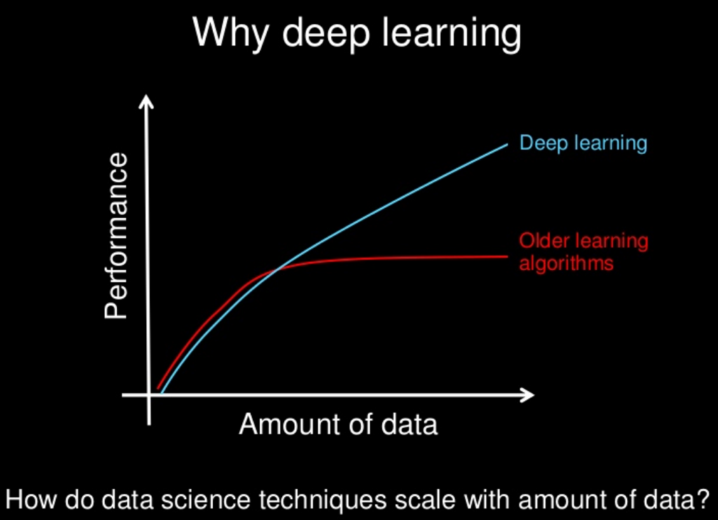
Shift to Convolutional Neural networks
Source: https://3qeqpr26caki16dnhd19sv6by6v-wpengine.netdna-ssl.com/wp-content/uploads/2016/08/Why-Deep-Learning-1024x742.png

Slide 21
Other Advantages of using CNN
Accuracy of Image classification using CNN far exceeds any other deep learning or other older machine learning algorithm.
It’s ability to learn features on its own, which was the biggest disadvantage of the older machine learning algorithms.
Features given to CNN model are just the pixel values of the image and so it creates a layer of abstraction for people without the knowledge on image processing.

Slide 22
References
https://en.wikipedia.org/wiki/Linear_discriminant_analysis
https://www.analyticsvidhya.com/blog/2017/09/understaing-support-vector-machine-example-code/
https://en.wikipedia.org/wiki/Artificial_neural_network
https://medium.com/@tifa2up/image-classification-using-deep-neural-networks-a-beginner-friendly-approach-using-tensorflow-94b0a090ccd4

Slide 23
References
Kurian J. and Karunakaran V. (2012). A Survey on Image Classification Methods. [online] Pdfs.semanticscholar.org. Available at: https://pdfs.semanticscholar.org/8fcc/28ca0cd491c62868ee8866784ee6cf40f374.pdf [Accessed 7 Feb. 2019].
Kamavisdar P., Saluja S. and Agrawal S. (2013). A Survey on Image Classification approaches and techniques. [online] Pdfs.semanticscholar.org. Available at: https://pdfs.semanticscholar.org/9509/c435260fce9dbceaf44b52791ac8fc5343bf.pdf [Accessed 7 Feb. 2019].
Nupur Thakur, Deepa Maheshwari. A REVIEW OF IMAGE CLASSIFICATION TECHNIQUES. Available at: https://www.irjet.net/archives/V4/i11/IRJET-V4I11287.pdf
Maneela Jain, Pushpendra Singh Tomar. Review of Image Classification Methods and Techniques. Available at: https://www.ijert.org/research/review-of-image-classification-methods-and-techniques-IJERTV2IS80157.pdf

Slide 24
Thank You

